Slide 1
IoT and Machine Learning based
Smart Kitchen Stove
CMPE 272- Enterprise Software Technologies
Professor Rakesh Ranjan
Prachi Chouksey
Sarthak Sugandhi
Maunil Swadas
Deep Khajanchi

Slide 2
User Stories
John and Anny are students and they are having hectic schedule all the semester. They hardly manage time to cook. In this case they prefer this product to be notified about their stove condition.
Julie is a working woman and a mother who has job in a corporate world. She has many duties and roles to play. She might forget about stove as she is always occupied in her work.
Allen is old aged person and he keeps on forgetting things. In the past he had faced two unwanted situations in kitchen. This product can save him from being in such situations next time.

Slide 3


Introduction
An IoT and Machine Learning driven Smart Stove accomplishes basic functionalities and unavoidable situations through which current condition and usage of kitchen stove can be tracked.

Slide 4
About Smart Kitchen Stove
This product plays a role of savior in many circumstances. A device Gyroscope has been used to read stove intensity and based on that, user can be notified about his stove condition. For that, we have created a Web application in which user can track record of stove in his home while doing his work from somewhere far.
A person can also ask Alexa about stove whether it is on or off and also for consumption units.
We have applied Machine Learning to predict forecast bill based on past and current consumptions and shows data in graphical manner. Therefore one can decrease his usage based on data if necessary.

Slide 5
Technologies in Smart Stove
Device:
Gyroscope
AWS instances
Machine Learning
Amazon Alexa
AWS Lambda
React
Internet Of Things
Python

Slide 6
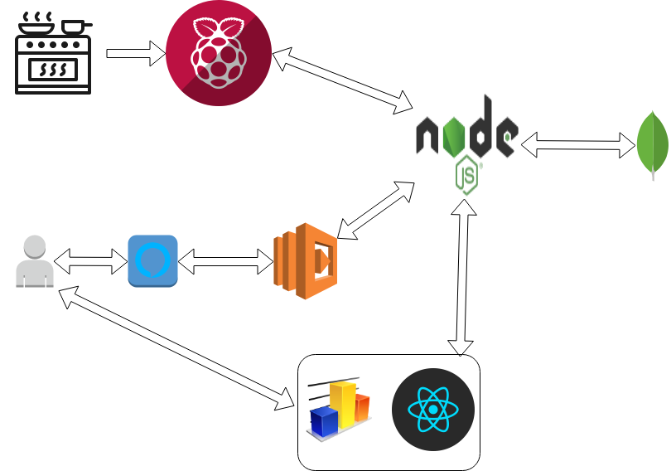
Architecture for Smart Stove

Slide 7
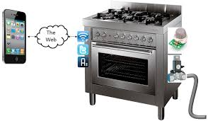
Demo

Slide 8
Future Goals
Usage warning if it exceed or near to maximum consumption units.
Automatic heat intensity according to food on stove.
Automatically turn stove off if necessary.
Email notification from mobile application.
Increase customer base.

